Slide 1
Advanced Mixed Integer Programming Formulation Techniques Nonlinear MIP Formulations
Joey Huchette and Juan Pablo Vielma
Massachusetts Institute of Technology
Spring School of the International Symposium on Combinatorial Optimization (ISCO 2018)
Marrakesh, Morocco, April, 2018

Slide 2
(Nonlinear) Mixed Integer Programming (MIP)

Slide 3
“Convex” Nonlinear MIP Problem
Only non-convexities are due to integrality

Slide 4
MI Second Order Cone Programming (MISOCP)

Slide 5
Second Order Conic or Conic Quadratic Problems
Problems using Euclidean norm:
e.g. Portfolio Optimization Problems

Slide 6
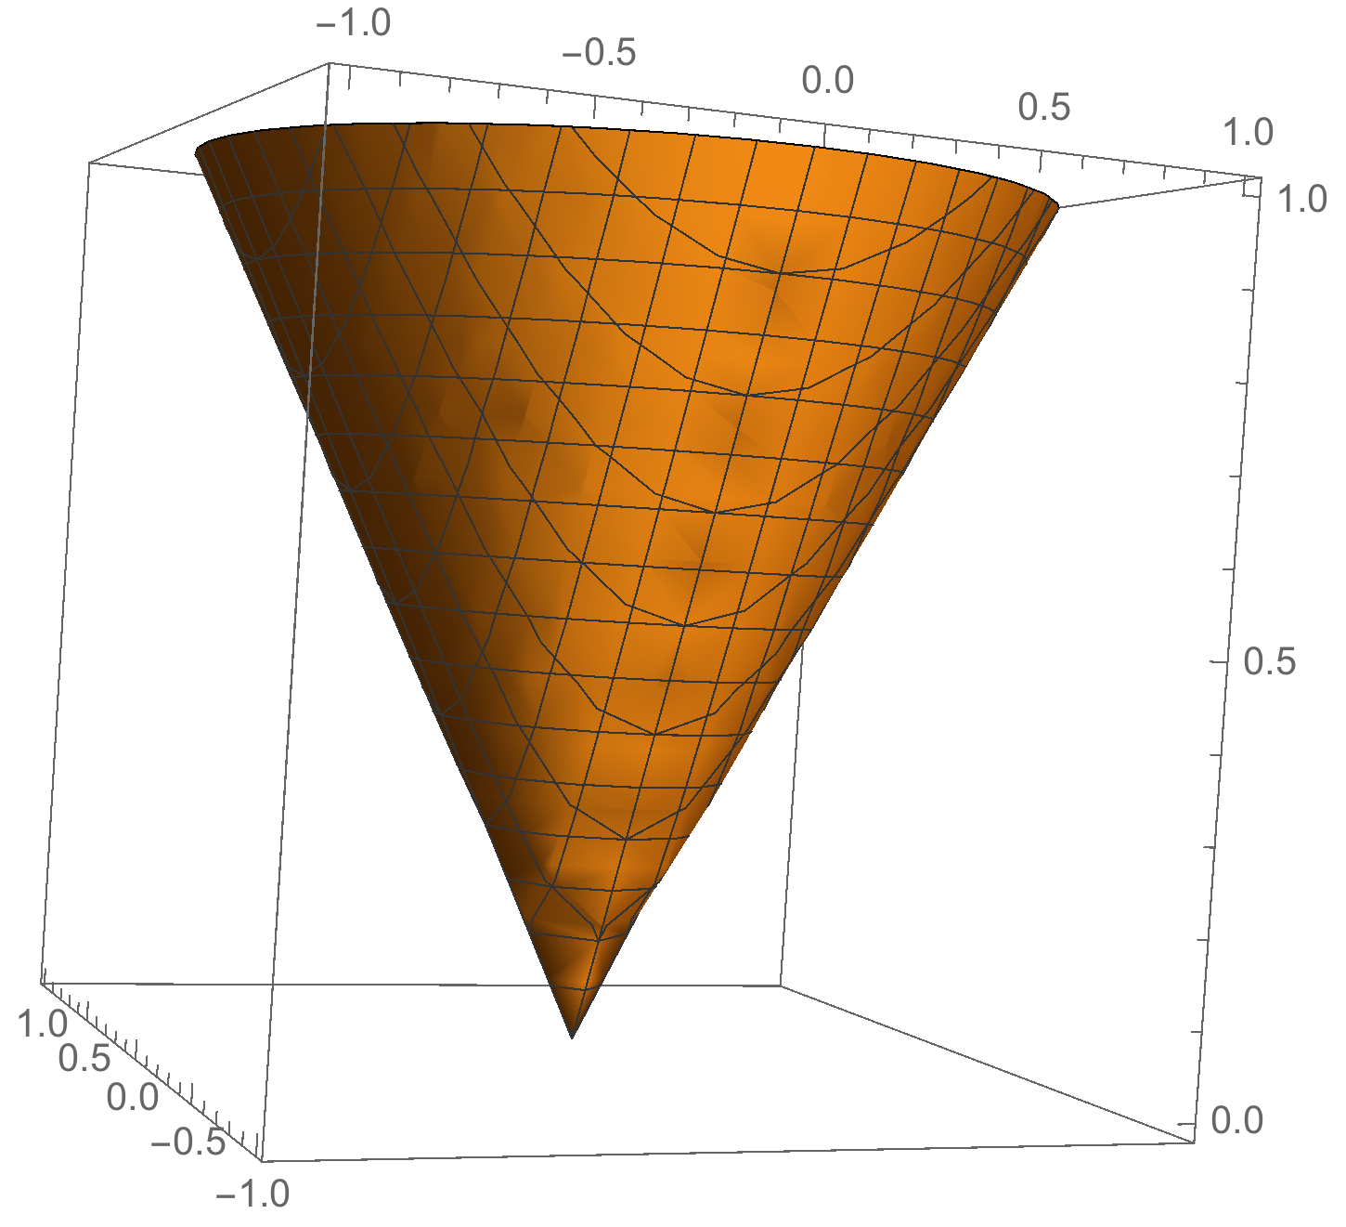
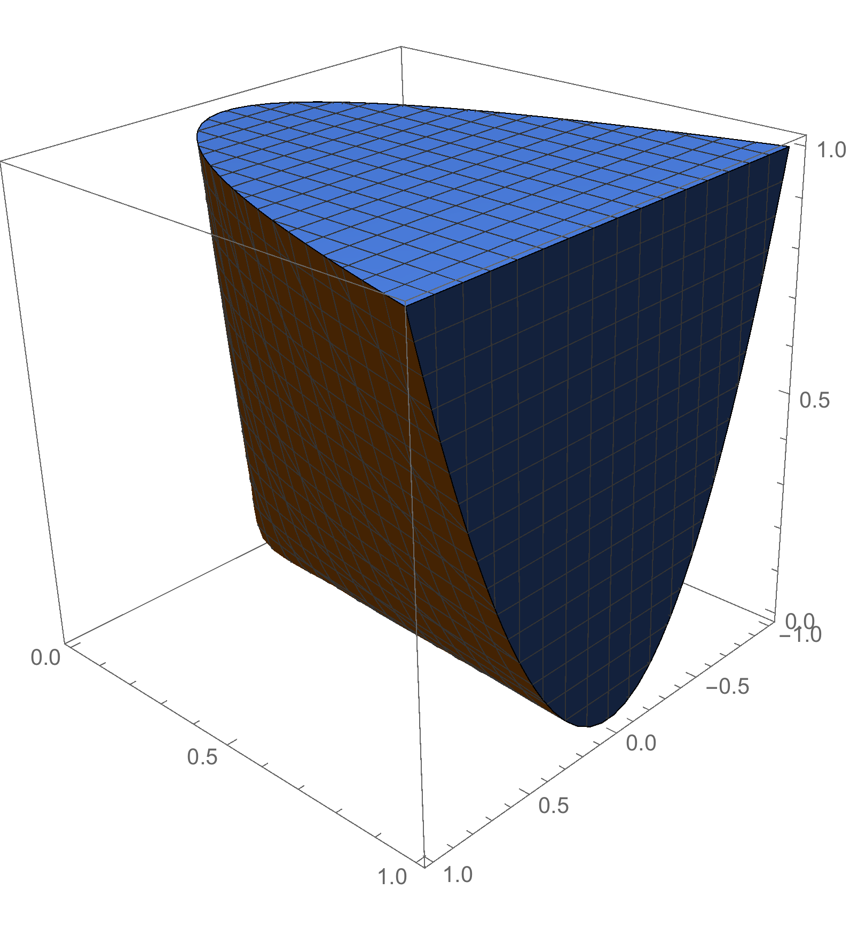
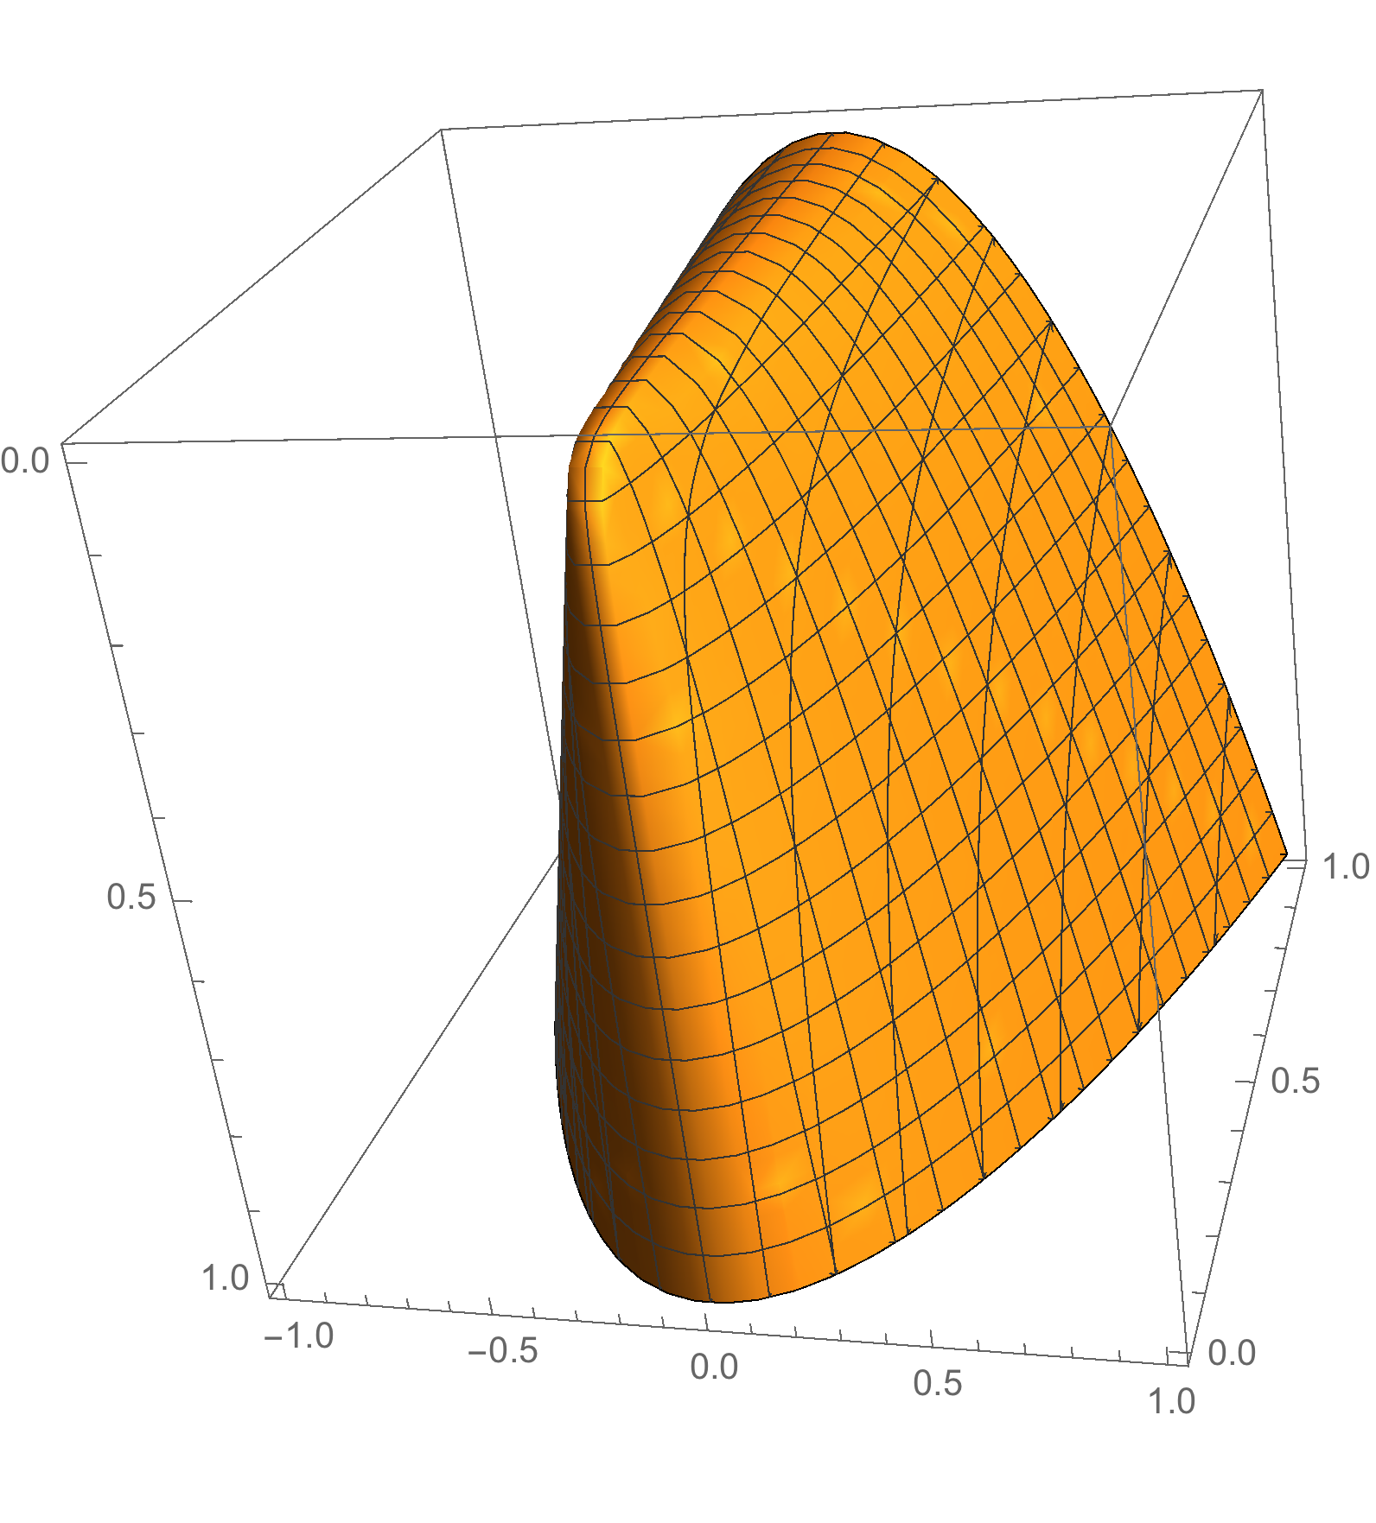
Conic Quadratic or Second Order Cone
Or linear inequalities +

Slide 7
Mixed Integer Conic Programming
Convex cone = closed under sum and scaling
Closed (usually pointed and maybe more)

Slide 8
Conic Duality
Cone dual to

Slide 9
Some Standard Cones

Slide 10
Also Nonlinear Mixed Integer Programming (MIP)
Example: Find minimum volume ellipsoid that contains 90% of data points

Slide 11
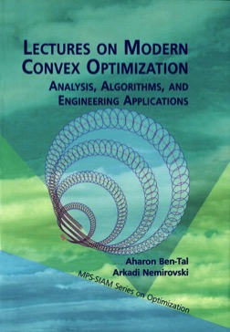
Minimum Volume Ellipsoid = SDP

Slide 12
Nonlinear MIP B&B Algorithms
NLP (QCP) Based B&B
(Dynamic) LP Based B&B
Few cuts = high speed.
Possible slow convergence.
Lifted LP B&B
Extended or Lifted relaxation.
Static relaxation
Mimic NLP B&B.
Dynamic relaxation
Standard LP B&B

Slide 13
LP v/s NLP B&B for CPLEX v11 for n = 20 and 30
Results from V., Ahmed and Nemhauser 2008.
Lifted LP
NLP
LP
Average Solve Times [s]

Slide 14
Dynamic Lifted LP for Separable Problems
Motivating example from Hijazi et al. ‘14

Slide 15
Lifted or Extended Approximations
Projection = multiply constraints.
V., A. and N. 2008:
Extremely accurate, but static and complex approximation by Ben-Tal and Nemirovski
V., Dunning, Huchette and Lubin 2016: Simple, dynamic and good approximation:
Image from Lipton and Regan, https://rjlipton.wordpress.com

Slide 16
CPLEX v12.6 for n = 20, 30, 40, 50 and 60
Time [s]
n
LP
NLP
New Lifted LP

Slide 17
Gurobi v5.6.3 for n = 20, 30, 40, 50 and 60
Time [s]
n
LP
NLP
New Lifted LP

Slide 18
All Major Solvers Now Implement Lifted LP
/
First Talks:
SIAM Optimization (SIOPT), May 2014 ≈ two weeks coding.
IBM Thomas J. Watson Research Center, December 2014.
Paper in arxive, May 28, 2015.
v12.6.2, June 12, 2015.
v6.5, October 2015.
v8.0, May 2016.
v4.0, March 2017.
Two weeks!
SCIP

Slide 19

However… We Can Sill Beat CPLEX!
/ -based solver Pajarito
Lubin, Yamangil, Bent and V. ’16 and Coey, Lubin and V. ’17.

Slide 20
Flexible Architecture Thanks to Julia-Opt Stack
Fastest Open Source MISOCP Solver!
Pajarito can also solve MISDPs and MI-“EXP”

Slide 21
Nonlinear Mixed 0-1 Integer Formulations
Modeling Finite Alternatives = Unions of Convex Sets
-

Slide 22
Extended and Non-Extended Formulations for
Extended
Non-Extended
Strong, but large
Small, but weak?

Slide 23
Extended Formulations: Perspective “v/s” Cones
e.g. Ceria and Soares ‘99
e.g. Ben-tal and Nemirovski ’01, Helton and Nie ‘09
Both formulations are ideal (extreme points of continuous relaxation satisfy integrality constraints)

Slide 24
Cones Can Mitigate Unintended Numerical Issues
Let where
Conic (SOCP) representation

Slide 25
Very Stable and Fast Conic Solvers
Matrices grow quadratically so you can easily run out of memory.
If it fits in memory you can probably solve relaxation
And then the MIP

Slide 26
Advanced Convex MINLP Formulations

Slide 27
A Classical Strong Formulation for
Auxiliary continuous variables are copies of original variables
“Ideal” Formulation Strength:
Extreme points of continuous relaxation satisfy integrality constraints on z
Variable copies crucial here, but slow down computations (usually worse than Big-M)
Balas, Jeroslow and Lowe (Polyhedral), Ben-tal, Nemirovski, Helton, Nie (Conic)

Slide 28
Generic Geometric Formulation = Gauge Functions
For such that let:
If then ideal formulation:

Slide 29
Non-Extended and Big-M Formulations
Gauge Big-M = no copies of original variables:
Can be stronger than standard big-M (e.g. or )
But may not be ideal
What about ideal non-extended formulations?

Slide 30
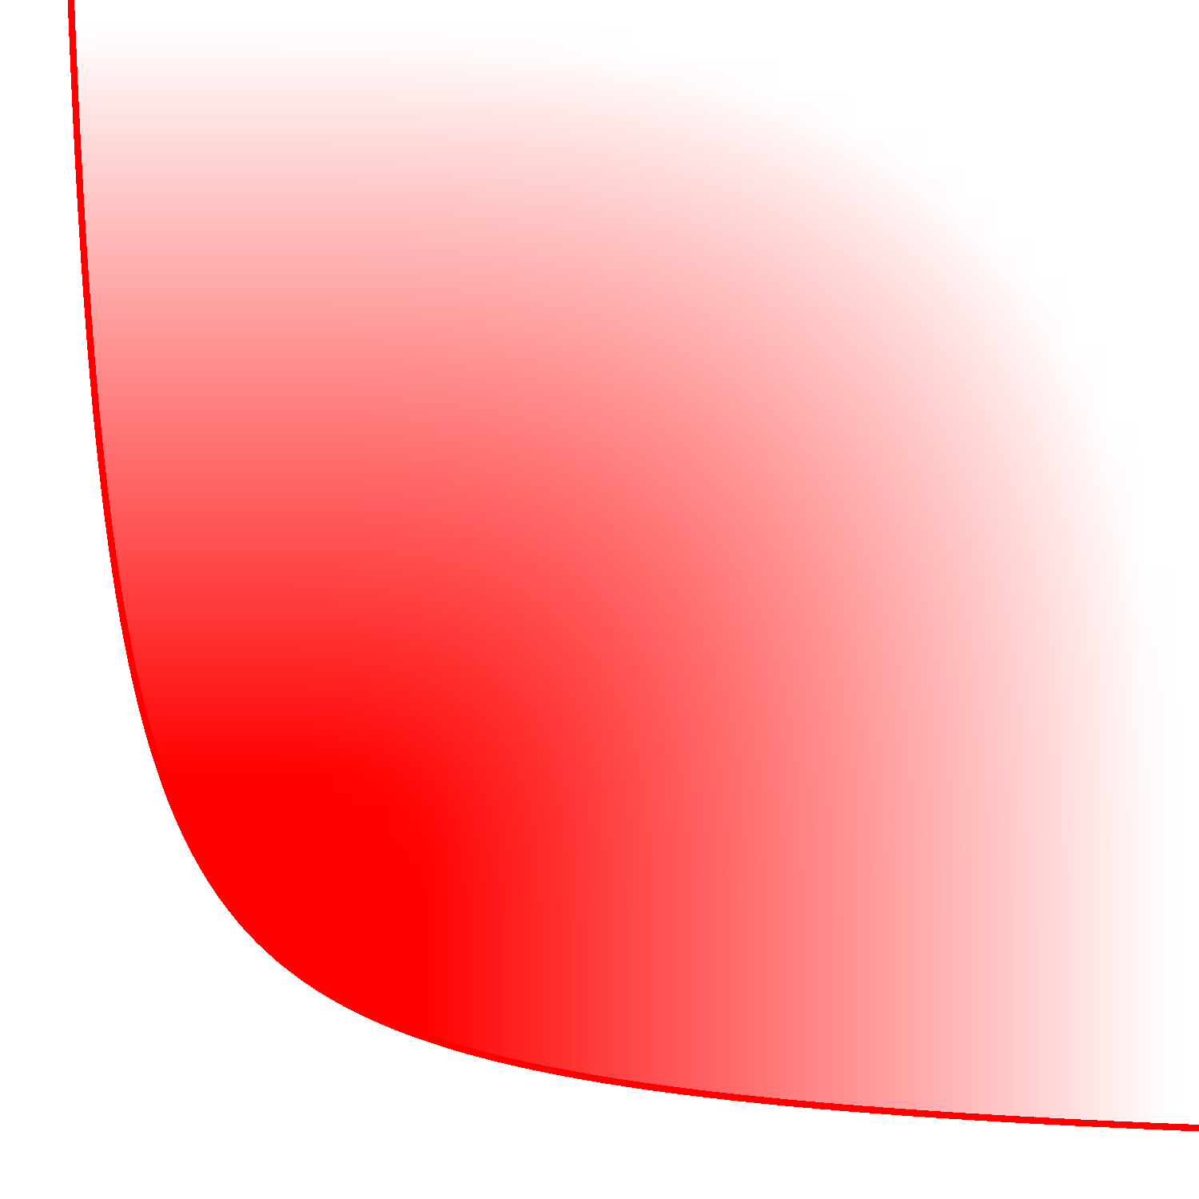

Simple Non-Extended Ideal Formulation
Unions of (nearly) Homothetic Closed Convex Sets:
Generalizes polyhedral results from Balas ‘85, Jeroslow ’88 and Blair ‘90

Slide 31
Unary Encoding, Minkowski Sum and Cayley Trick

Slide 32
Faces of Cayley Embedding
Two types of facets (or faces):
Not all combinations of faces
Which ones are valid?

Slide 33
Valid Combinations = Common Normals

Slide 34
Characterization Extends to Closed Convex Sets

Slide 35
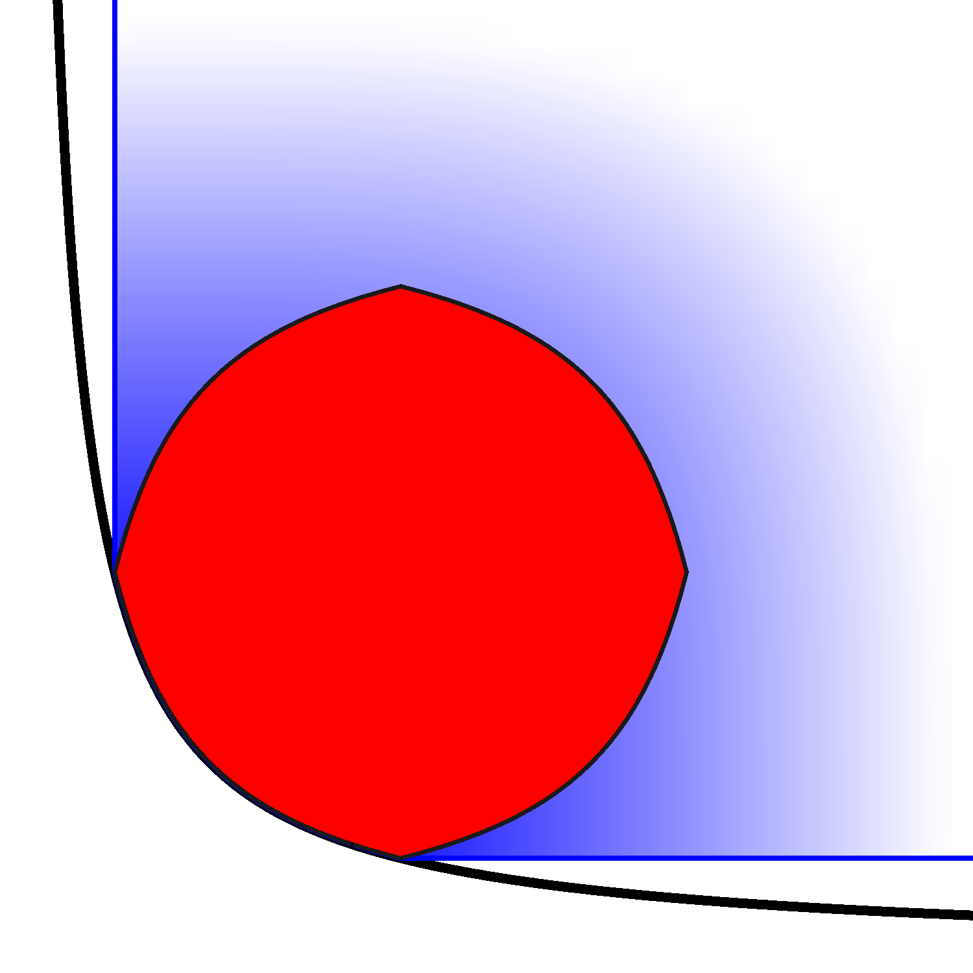
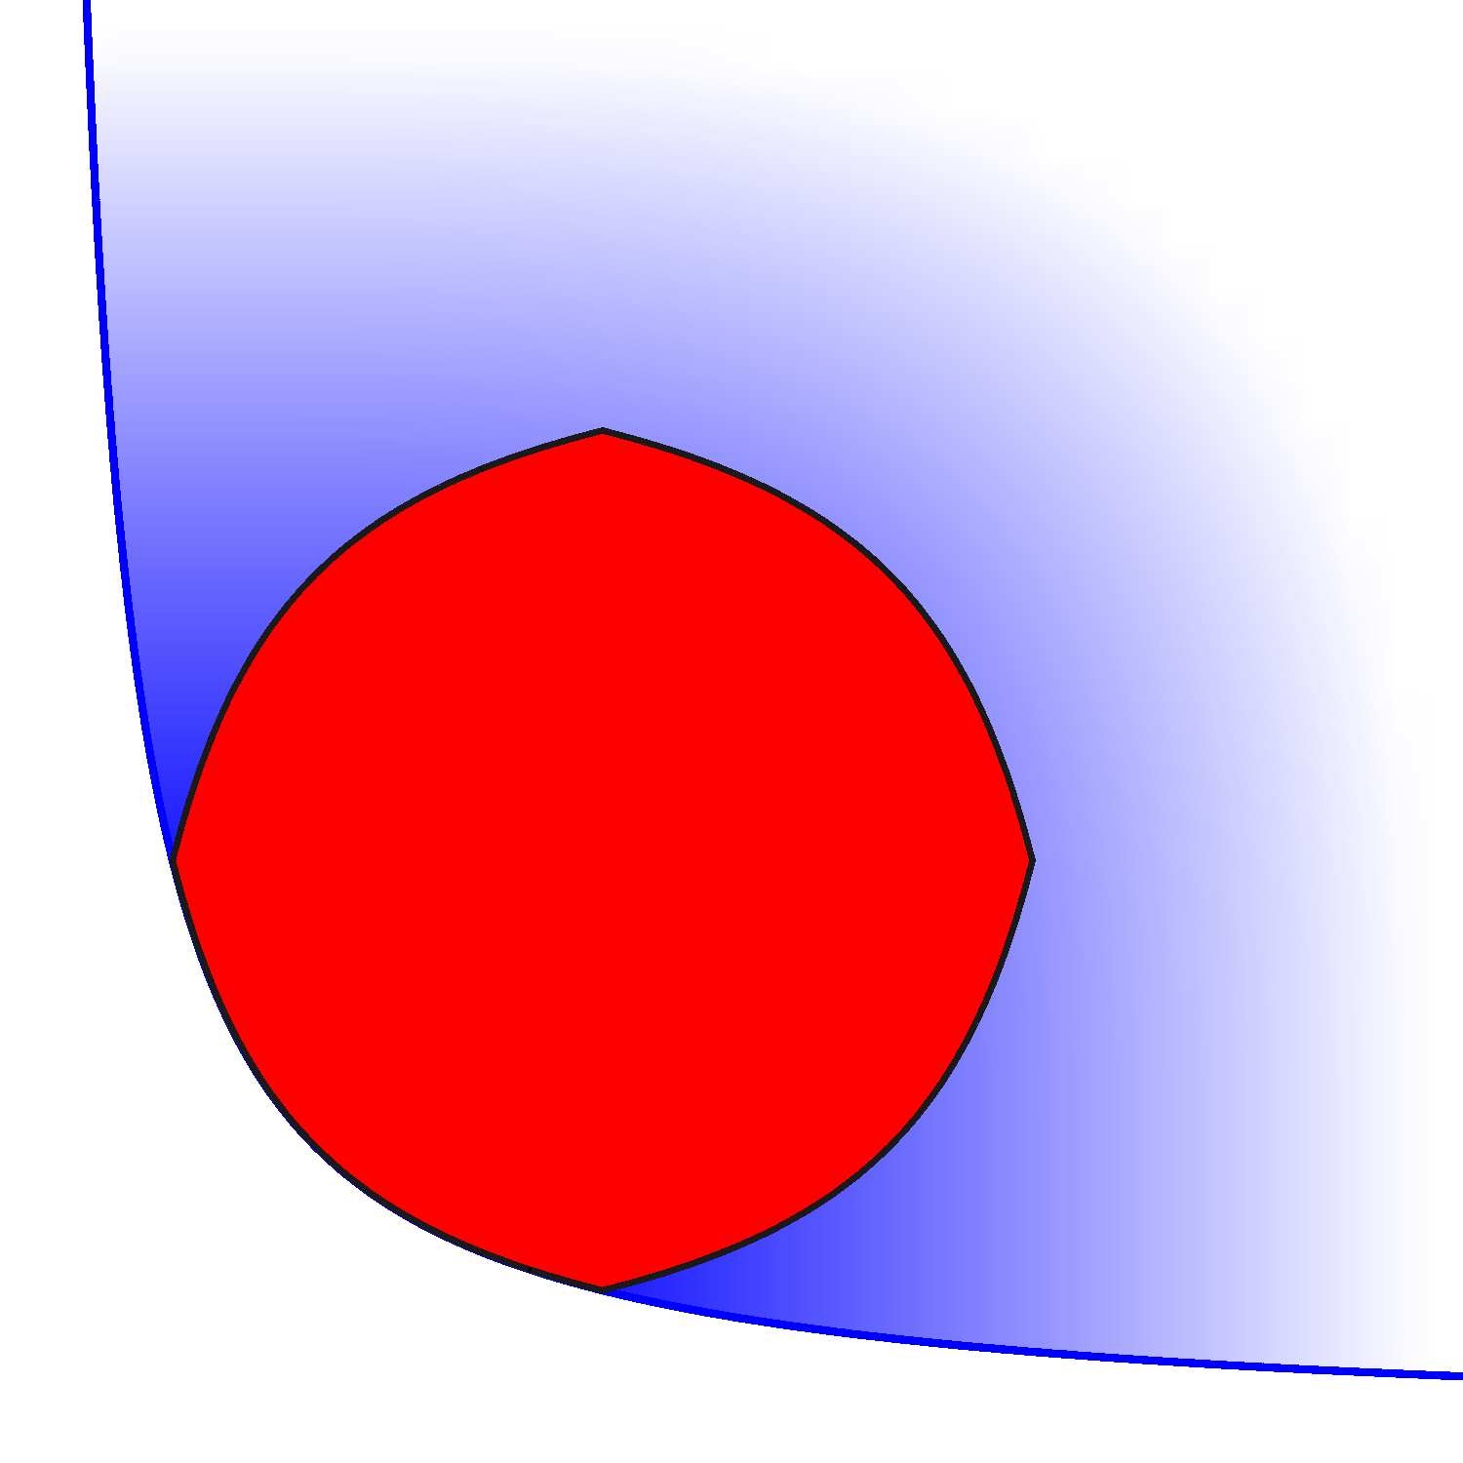
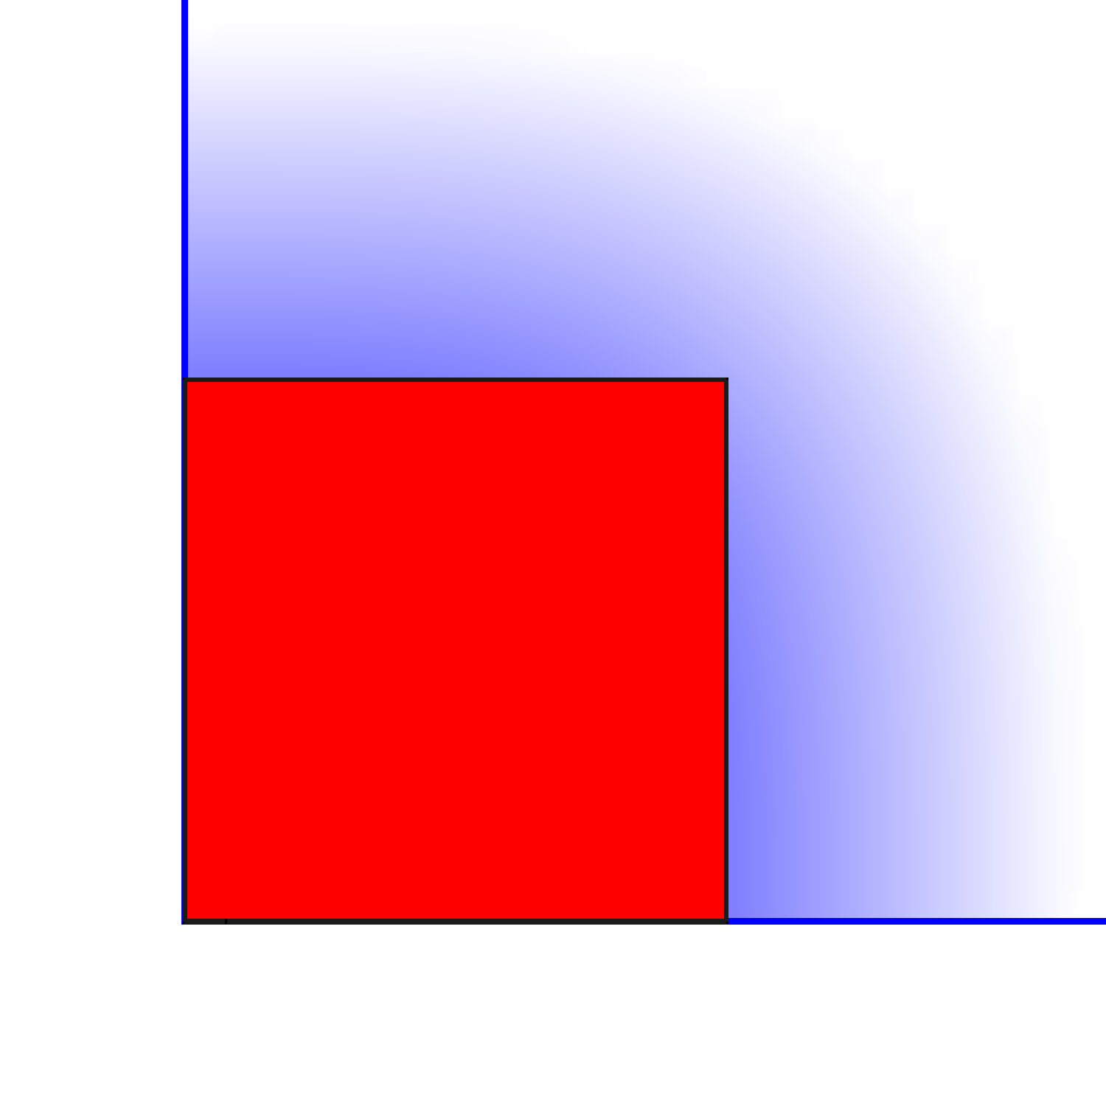
Sticking Homothetic Formulations Together
Valid, but not ideal!
Combine 4 homothetic formulations
Right relaxations yield ideal formulation

Slide 36
Sufficient Conditions For Ideal Formulation
Similar to “lifting” of e.g. Tawarmalani et al. ‘10

Slide 37
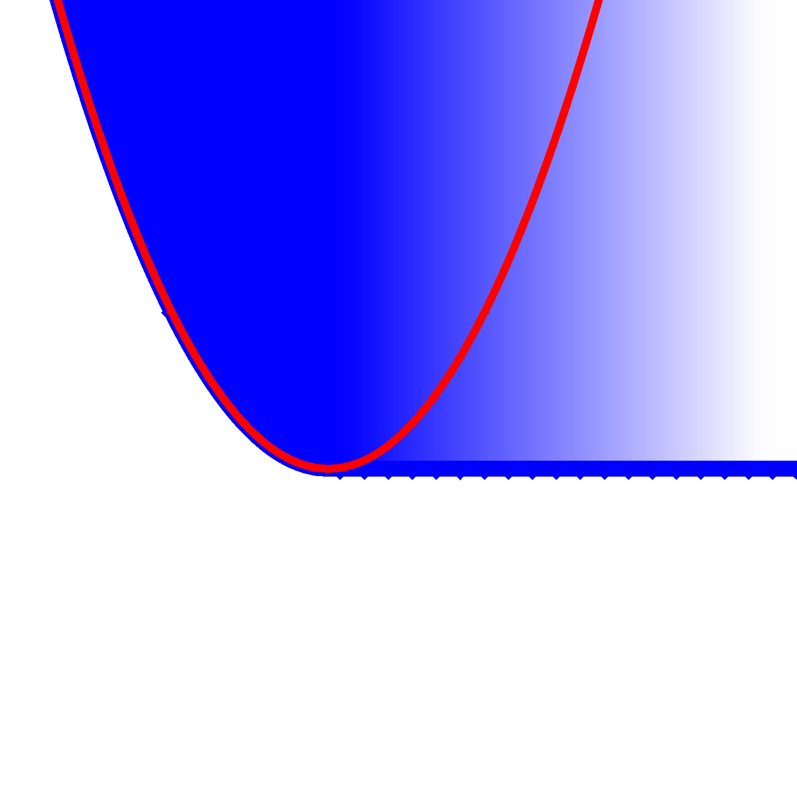
May Need to “Find” Homothetic Constraints

Slide 38
Existing Small Ideal Formulations (Isotone Sets)
Studied by Hijazi et al. ‘12 and Bonami et al. ’15 (n=1, 2):
component-wise monotonous (i=1,2 opposite).
Ideal Formulation

Slide 39
Generalization and Simplification
More than 2 sets (with general “opposite condition”).
Generalization of the monotone/isotone condition (beyond affine transformation)
Significantly smaller formulation: One non-linear constraint per set.

Slide 40
Details of Size Reduction
Original formulation:
Smaller formulation:
max can cause representability issues.

Slide 41
Algebraic Representation Issues
Non-basic semi-algebraic set contained in formulation.
Finite polynomial inequalities requires max or auxiliary vars.

